Slide 1
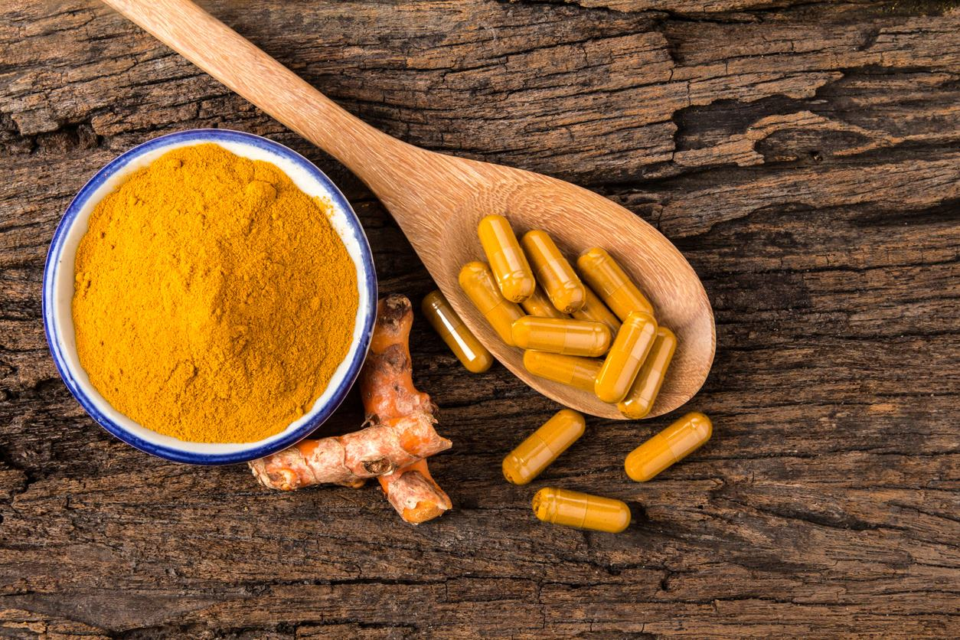
Bioavailable Curcumin
United States Analysis

Slide 2
BioCurcumin: US Analysis Summary
Country Covered
USA
12
No. of Buyers
No. of Suppliers
12
Buying Quantity
186
Total Brands
9
15-16
Data Duration Year

